Slide 1
Structural vs Behavioral
"Structural patterns are concerned with how classes and objects are composed to form larger structures.”
"Behavior patterns are concerted with algorithms and the assignment of responsibilities between objects. Behavioral patterns describe not just the patterns of objects or classes but also the patterns of communication between them.”

Slide 2
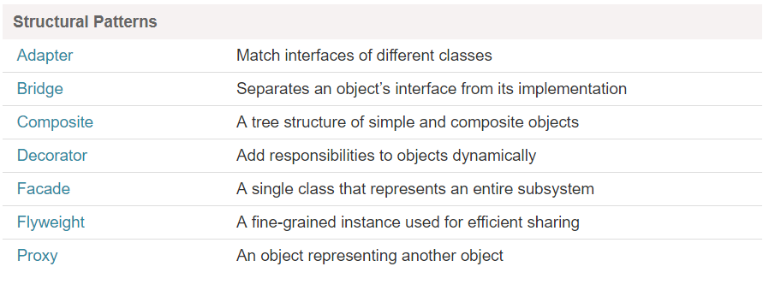
Summary

Slide 3
Behavioral Patterns
Deal with the details of assigning responsibilities between different objects.
Describe the communication mechanism between objects.
Define the mechanism for choosing different algorithms by different objects at runtime.

Slide 4
Observer Pattern
Object Behavioral

Slide 5
Intent
Define a one-to-many dependency between
objects so that when one object changes
state, all its dependents are notified and
updated automatically.

Slide 6
Observer Pattern
Also Known as: Dependents, Publish-Subscribe
A common side-effect of partitioning a system into a collection of cooperating classes is the need to maintain consistency between related objects.
The key objects in the Observer pattern are Subject and Observer.
A subject may have any number of dependent observers.
All observers are notified whenever the subject undergoes a change in state.
In response, each observer will query the subject to synchronize its state with the subject´s state.

Slide 7
Design Principle
Strive for loosely coupled designs between
objects that interact.

Slide 8
The power of loose coupling
The Observer Pattern provides an object design
where subjects and observers are loosely coupled
We can add new observers at any time
We never need to modify the subject to add new
types of observers
We can reuse subject and observers independently of each other
Changes to either the subject or an observers will not affect the other

Slide 9
observers
Subject
Attach(Observer)
Detach(Observer)
Notify()
Observer
Update()
Forall o in observers
o->Update()
subject
ConcreteObserver
Update()
observer_state
ConcreteSubject
GetState()
SetState()
subject_state
observer_state=
subject->GetState()

Slide 10
Applicability
When an abstraction has two aspects, one dependent on the other. Encapsulating these aspects in separate objects lets you vary and reuse them independently.
When a change to one object requires changing others, and you do not know how many objects need to be changed.
When an object should be able to notify other objects without making assumptions about who these objects are.

Slide 11
Participants
Subject
Knows its observers. Any number of Observer objects may observe a subject.
Provides an interface for attaching and detaching Observer Objects.
Observer
Defines an updating interface for objects that should be notified of changes in a subject

Slide 12
Participants
ConcreteSubject
Stores a state of interest to ConcreteObserver objects.
Sends a notification to its observers when its state changes.
ConcreteObserver
Maintains a reference to a ConcreteSubject object
Stores state that should stay consistent with the subject state.
Implements the Observer updating interface to keep its state consistent with the subject state.

Slide 13
Collaborations
ConcreteSubject notifies its observers whenever a change occurs that could make its observer’s state inconsistent with its own.
After being informed of a change in the ConcreteSubject, a ConcreteObserver object may query the subject for information. ConcreteObserver uses this information to reconcile its state with that of the object.

Slide 14
ConcreteSubject
Object
ConcreteObserver
ObjectA
ConcreteObserver
ObjectB
SetState()
Notify()
Update()
GetState()
Update()
GetState()

Slide 15
Sequence Diagram
Note that the Observer object that initiates the change request with SetState() postpones its update until it gets a notification from the subject.
In this scenario Notify() is called by the subject, but it can be called by an observer or by another kind of object.

Slide 16
Implementation
Pull model:
The pull model emphasizes the subject’s ignorance of its obervers. The pull model may be inefficient, because Observer classes must infer what changed without help from Subject.
Push model:
The push model assumes that the subject knows something about its obervers’ needs.
The push model might make observers less reusable because Subject classes make assumptions about Observer classes that might not always be true.

Slide 17
Consequences
The Observer pattern lets you vary subjects and observers independently.
Abstract coupling between Subject and Object
Support for broadcast communication
Unexpected Updates

Slide 18
Subject
Interface
Browser
PDA
Cell Phone
Terminal
XML
xyz…
Data is sent to the various observers
Web
Browser
PDA
Cell
Phone
Terminal
Observers

Slide 19
Related Patterns
Mediator – an object in the middle intercepts all update requests and broadcasts them to other objects
Singleton – A “single” subject object instance can be implemented with a Singleton

Slide 20
Java example
import java.util.Observable; import java.util.Observer; public class MessageBoard extends Observable { private String message; public String getMessage() { return message; } public void changeMessage(String message) { this.message = message; setChanged(); notifyObservers(message); }

Slide 21
Java example
public static void main(String[] args) { MessageBoard board = new MessageBoard(); Student bob = new Student(); Student joe = new Student(); board.addObserver(bob); board.addObserver(joe); board.changeMessage("More Homework!"); } } class Student implements Observer { public void update(Observable o, Object arg) { System.out.println("Message board changed: " + arg); } }

